Slide 1
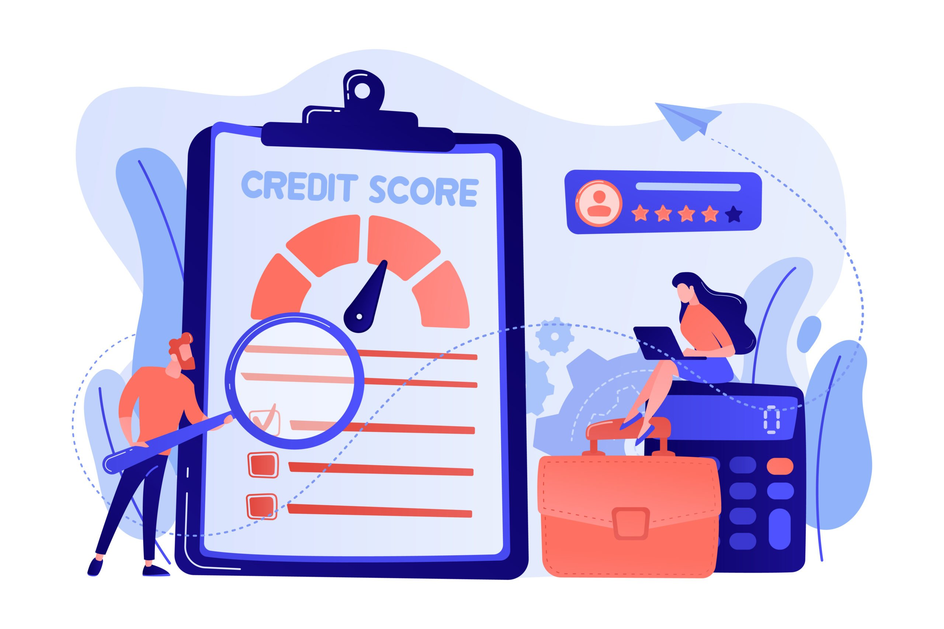

Credit Risk Analysis
ISM 6358
Yayuan Zhang
Dashboard Link

Slide 2



Overall Analysis Process
Tools: PowerBI & Python
Read in the Data
Relevent features
Relationship
Data type
Null values
Outliers values
Missing values
Data Preparation
Feature engineering
Outlier Box Plot
Add new cols: Total Balance…
Transformation
EDA & Viz
Heatmap
Pie
Scatter
Histogram
Cards
Key Influencers
Model selection
Logistic Regression
KNN
Random Forest
SVC - linear
SVC - rbf
Logistic Regression
70% train set
Confusion Metrix
Accuracy
AUC ROC
Analysis & Recommendations
Business Statement
Discoveries & Analysis
Modeling
Recommendations
3W

Slide 3
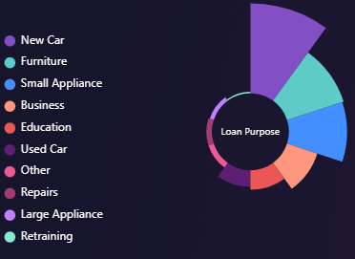
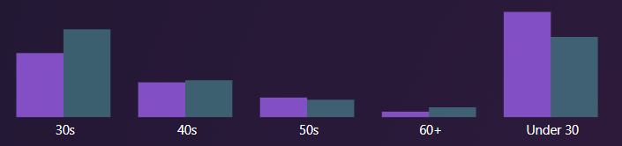
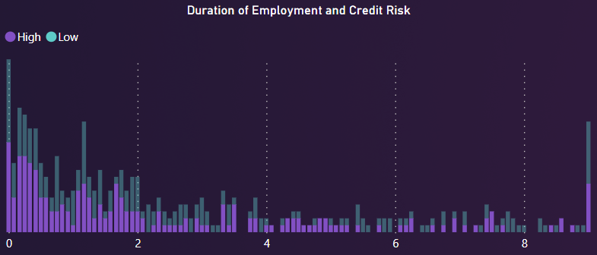
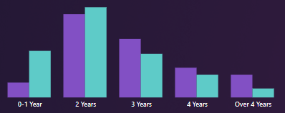
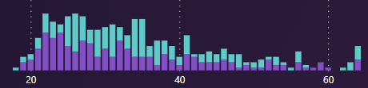
Business Statement
What factors influence default risk/credit risk?
What is the profile of high-risk and low-risk individuals?
Loan Purpose
Age Group
Duration of Employment
Customer relationship
Purchase New car
More than 24
Short term employment lifetime
More than 1 year
Business Statement
Discoveries & Analysis
Modeling
Recommendations
3W

Slide 4
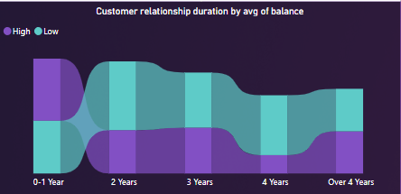
Discoveries
Long term relationship with the bank and maintain high average of total balance have lower credit risk.
Stable customer relationships with banks indicate loyalty and long-term financial stability.
These customers tend to have higher average balances, which suggests they have shown financial stability and responsible loan management over time.
Longer relationships can lead to improved credit scores, favorable loan conditions, and lower interest rates.
Business development and customer care practices influence customer relationships and savings balances.
Business Statement
Discoveries & Analysis
Modeling
Recommendations
3W

Slide 5
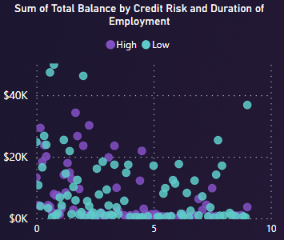
Discoveries
Customers with longer employment tenure have lower total balance and Credit Risk in the bank.
Long-term employed customers have established financial stability and may not rely on bank loans or credit.
They likely have sufficient funds for expenses, including consumption and investments, resulting in lower total balance.
Their extended credit history and financial stability contribute to lower credit risk.
They may hold their assets in accounts at other banks.
Business Statement
Discoveries & Analysis
Modeling
Recommendations
3W

Slide 6

Recommendations Sustainable business strategy and customer service for Low risk customer group
Special Incentives & Personalized Services
Education and financial planning support
Flexible loan products
Financial advice
Lower interest rates
Investment planning
more attractive preferential terms
Retirement planning
For the customer with longer employment tenure & long-term relationship with high balance.
Business Statement
Discoveries & Analysis
Modeling
Recommendations
3W

Slide 7

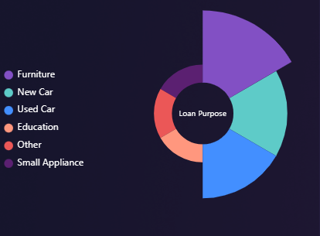
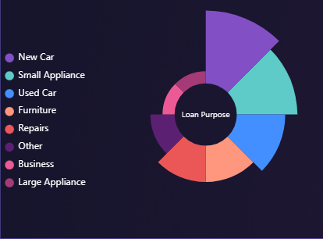
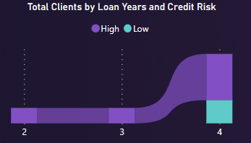
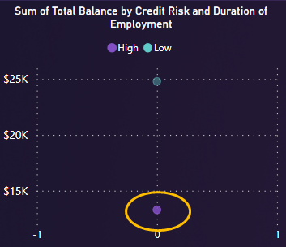
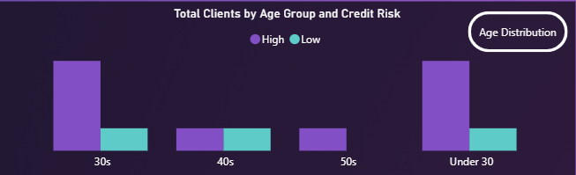
Discoveries
High risk customer group without any deposits and employment records.
Customer without any deposits in the bank
Customer with no employment records
Under of 40 years old
Purchase Vehicles
Purchase Vehicles
Purchase small appliance
Purchase Furniture
Low deposit amounts
Repayment period over 1 year
Business Statement
Discoveries & Analysis
Modeling
Recommendations
3W

Slide 8
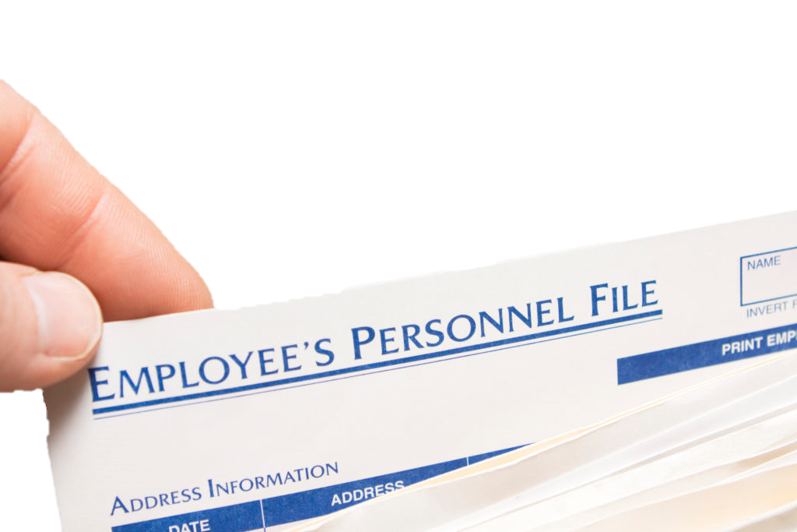
Recommendations(cont.) Sustainable business strategy and customer service for High-risk customer group
Request additional information
Create flexible repayment plan
Deposit Statement
Educational background
Employment proof
Collateral
Repayment capability
Change of risk status
Provide extra support
Risk management
Vehicles
Real estate
Inventory
Reduce burden
Improve repayment efficiency
Machinery & equipment
Stocks and bonds

Slide 9
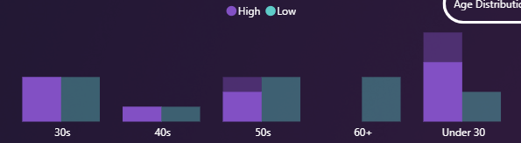
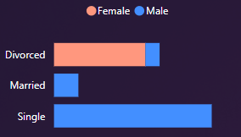
Recommendations(cont.) Comprehensive assessment: Insufficient data & clearly type
Missing Evaluation Factors
Industry background
Educational background
Credit history
Income information
Debt Information
Debt Information
Uncertain Type
Job
No self-employed option
e.g. 10 clients in management or skilled positions with 0 month of employment
Imbalance Data Collection
Only divorced women data
More skewed toward younger groups
Develop diversity client group
Balance the risk
Long-term customer loyalty
Market expansion opportunities
Positive brand image

Slide 10
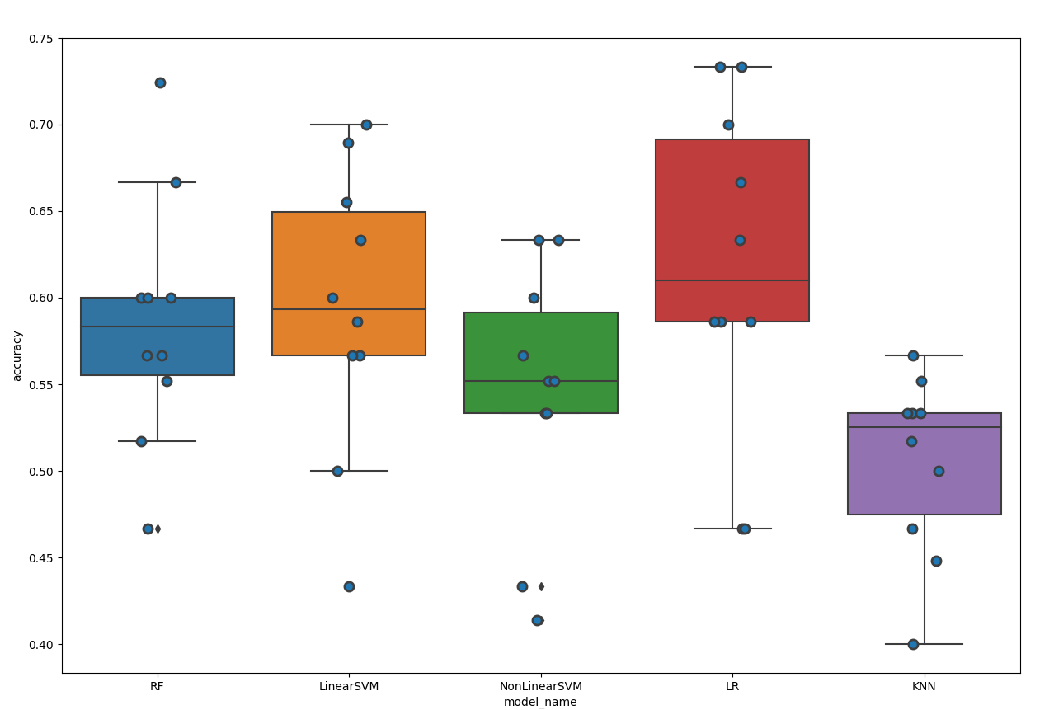
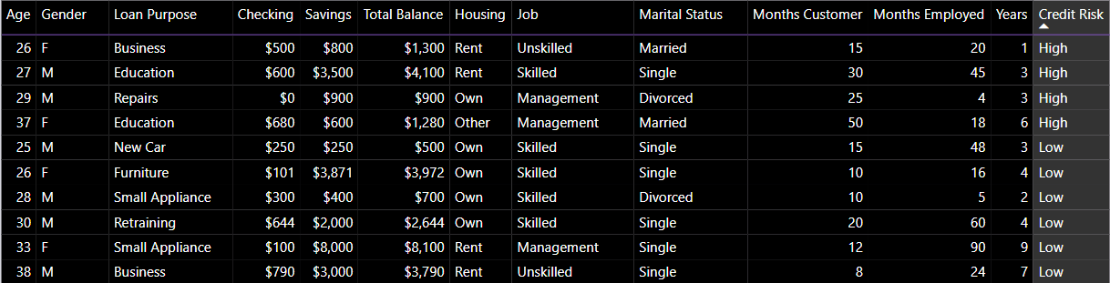
Modeling – Additional Data
Logistic Regression
Linear SVM SVC (kernel=linear)
KNN
Random Forest
Linear SVM SVC (kernel=rbf)
K-Folds Cross-validation method
ROC 0.61
Business Statement
Discoveries
Modeling
Recommendations
3W

Slide 11
Went Well
Didn’t went well
Differently next time
Choose tools
EDA
Evaluated Recommendations
Data prep
Check for variability in the dataset
No null values
Found outlier values – Box Plot
Found imbalanced dataset
Added new features
Transform month to year
Zero value analysis
Thanks Panda Profiling Report
Power BI
Dashboards
Bookmark button
Slicer panel page
Tooltips pages
Data preprocessing
Handle outlier values
Confused outlier values with some values
e.g. 10 clients in management or skilled positions with 0 month of employment after I handle the outlier by Python. This issues is not an outlier because there is no self-employed option.
Model
Insufficient data
Recommendations
Outlier
Panda Profiling Report
Fully understand data background and business logic – why outlier occur.
Set aside some time to read from different angles if it's something you can't figure out.
Business Statement
Discoveries
Modeling
Recommendations
3W

Slide 12
Thank you for watching!

